Slide 1

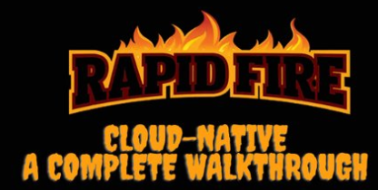
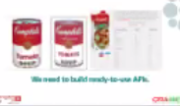
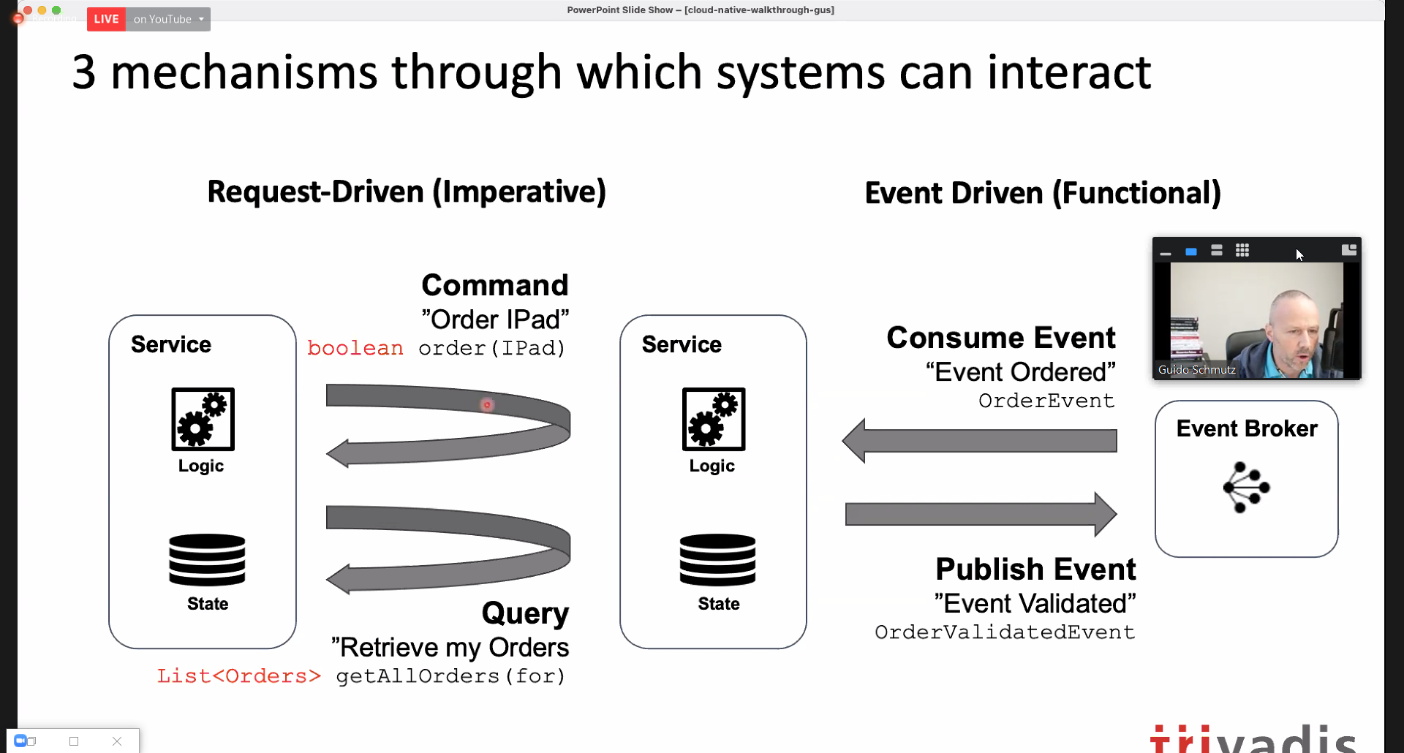
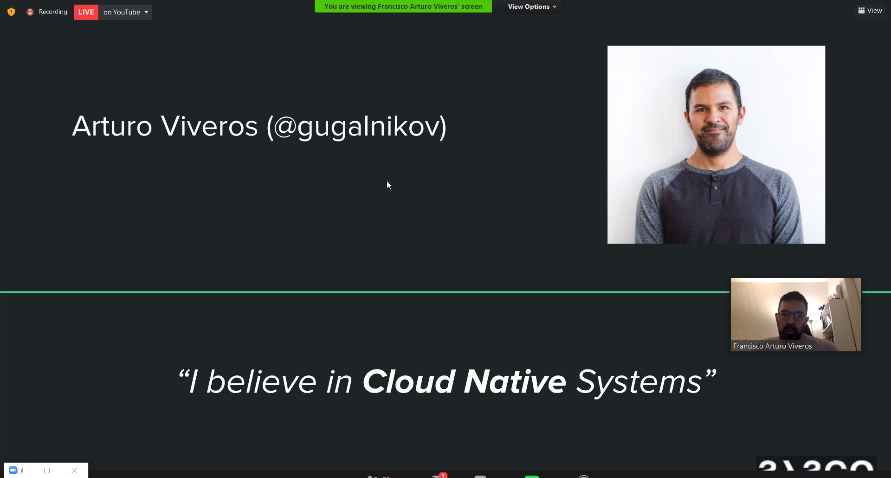
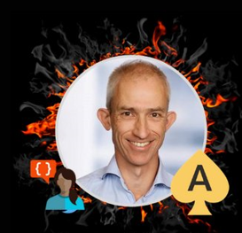
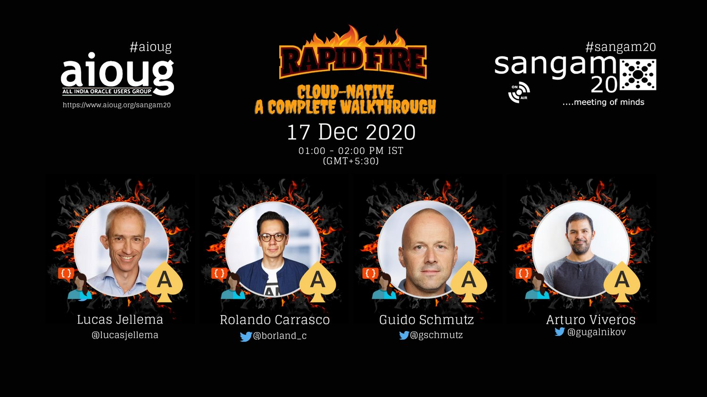
Rapid Fire Cloud Native Overview
Sangam 20, December 2020
Lucas Jellema, CTO & Architect AMIS | Conclusion
Notes:
My angle will be the overall considerations – benefits and challenges/decision points – with cloud native. Deciding how “all in” you want to go with the cloud vendor (go serverless on a proprietary framework or stick with K8S for example); for me, automation and dynamic scalability are important elements – as I am sure they are for you so perhaps these are among our touch points.
I will also talk about development productivity and innovation rate – I suspect these are less to be used for bridging our two segment.

Slide 2
A traditional application
UI
API
WebApp
Platform & Language runtime features (transaction management, HTTP request handling, state management & in memory caching, IAM, …
3rd party libraries & frameworks
Monolith, Microservice, Module
Custom Code
Database (RDBMS?)
Java EE
JVM
Operating System
Hardware

Slide 3
Cloud Native Application
Cache
CDN & WAF
API Gateway
Function
Event Hub
Web App
Container Engine
Function
IAM
Managed
Quick Provision & Decommission
Distributed
Automated
Pay per use/TCO
Vendor takes runtime responsibility
Enterprise grade platform accessible to startups
Rapid Innovation
Security & Availability
Scale
Vault
Mail
Data Integration
PaaS
Monitor
Alert & Notify
Scaling
Logging
IaaS
Notes:
Out of the box PaaS services and facilities
persistence, routing/throttling/buffer/queue/retry
IDM, key mgt, encryption/decryption
Distribution, CDN, regional failover
Monitor, log, alert/notification
Scalability (up & down)
Quick Rampup
Emphasis on interaction points: APIs, Events/ message format
Less emphasis on implementation of PaaS (platform) services
MongoDB API – implemented by Azure Cosmos DB, MongoDB, Minimongo and AWS Document DB and soon Oracle Autonomous JSON
Kafka API – Azure Event Hub, OCI Streaming, AWS Managed Streaming
JDBC/SQL – Relational Database (Oracle, SQL Server, PostgreSQL, MySQL) and even NoSQL (Oracle NoSQL, Cassandra, Hadoop)

Slide 4
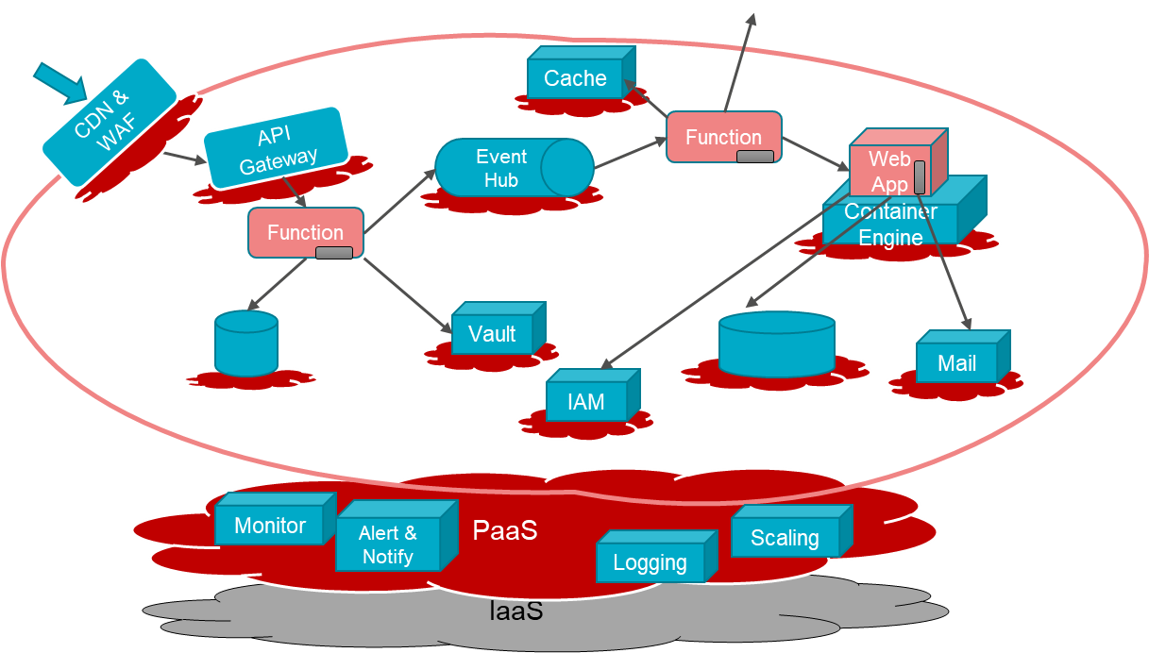
Characteristics of Cloud Native Applications
Modern – born in the cloud (era)
Emphasis on interaction (and decoupling) points:
Between custom components: APIs, Events / message format
From custom to PaaS Services: Service APIs, Formats and Protocols
Less emphasis on [and insulation from?] implementation of PaaS (platform) services
Key are industry standard APIs that are implemented by many different services
Custom code in small, simple units
No explicit Infrastructure (serverless, software defined) & managed Platform components
Stateless and Dynamically Scalable (Elastic) – expand and contract as required
Pay per Use
Automation – no hands on ACC and Production (speed, repeatability, dynamic adjustment)
Infrastructure/Platform as Code & Application CI/CD [pipelines]
Notes:
MongoDB API – implemented by Azure Cosmos DB, MongoDB, Minimongo and AWS Document DB and soon Oracle Autonomous JSON
Kafka API – Azure Event Hub, OCI Streaming, AWS Managed Streaming
JDBC/SQL – Relational Database (Oracle, SQL Server, PostgreSQL, MySQL) and even NoSQL (Oracle NoSQL, Cassandra, Hadoop)

Slide 5




Not everything is rosy and pearly
Vendor Lock-In
strategic directions and roadmaps
pricing strategy
conflict of interest
Network Latency
“hidden costs”
for example: data egress
Physical and Legal location of data
…

Slide 6






Traditional Application: Tweets to NoSQL, Streaming & Email
Function
Object Storage
Function
Events
Notifications
NoSQL Database
API Gateway
Healthcheck
Streaming
#sangam20

Slide 7
Traditional Application: Tweets to NoSQL, Streaming & Email
A single unit to build | test | deploy | scale | fail
Synchronous (internal) interactions
No (built-in) monitoring | logging
API
WebApp
3rd party libraries & frameworks
log
Database (RDBMS?)
Java EE
JVM
NoSQL Database
Streaming
#sangam20
Operating System
Platform and Infrastructure to install | configure | secure | operate | maintain
Hardware
Logging?
Monitoring?

Slide 8


Demonstration of Cloud Native Application on OCI: Tweets to NoSQL, Streaming & Email
Function
Object Storage
Function
Events
Notifications
NoSQL Database
API Gateway
Healthcheck
Streaming
#sangam20

Slide 9






Cloud Native design Tweets to NoSQL, Streaming & Email
Store JSON file with all tweets in time period
Cloud Event for new JSON file
Create Tweet Records in NoSQL
Trigger function with event
Invoke Tweet Aggregator every X minutes
NoSQL Database
Function
Publish to Notification Topic
Expose function to external callers
Object Storage
Healthcheck
Write JSON document with Tweets
Custom code in multiple small units that each build | test | deploy | scale | fail
Asynchronous interactions
Managed Platform (and underlying Infra) with built in logging | monitoring | Ops Configured through Infra as Code
API Gateway
Streaming
Events
Publish each Tweet to Stream
Function
Retrieve X minutes worth of tweets
Notifications
Send Tweet Report as email
Get Twitter credentials in secure way from vault
Vault
Logging
Container Registry
Monitoring
#sangam20
Auditing

Slide 10

Decoupling
Encapsulation (of implementation)
Run time availability independence
Independent release / reconfigure
Independence of scaling
Volume Load Throttling/Absorption
Security Boundary
Failure isolation
NoSQL Database
Function
Object Storage
API Gateway
Streaming
Events
Function
Notification Topic
Vault
Logging
Container Registry
Monitoring
#sangam20
Auditing

Slide 11


Conclusion
Cloud is not an easy solution for the big problems
it can quickly help with scale, security, focus on business value, automation, innovation, TCO, and with starting the right discussions
it does not add agility to existing business critical applications and teams
and adopting the cloud is not a trivial operation
Cloud Native means leveraging cloud to the fullest
embrace rapid innovation, work completely serverless and with dynamic scale
build on fully managed, rich platform services and DevOps facilities
build on deep trust in the Cloud provider – no easy way out
There is no excuse for not starting your cloud journey right now
except if you are already on your way – in that case: have a safe journey!

